Slide 1

Finding the “why” Portfolio Presentation
John a. Christman

Slide 2
The Two “Whys”
Why are the tools and techniques taught important?
Use Cases
PROS/CONS
Real-world application
Why does the project bring value?
How can the results be applied
What actions can be taken based on the results
Who would be interested in the findings

Slide 3
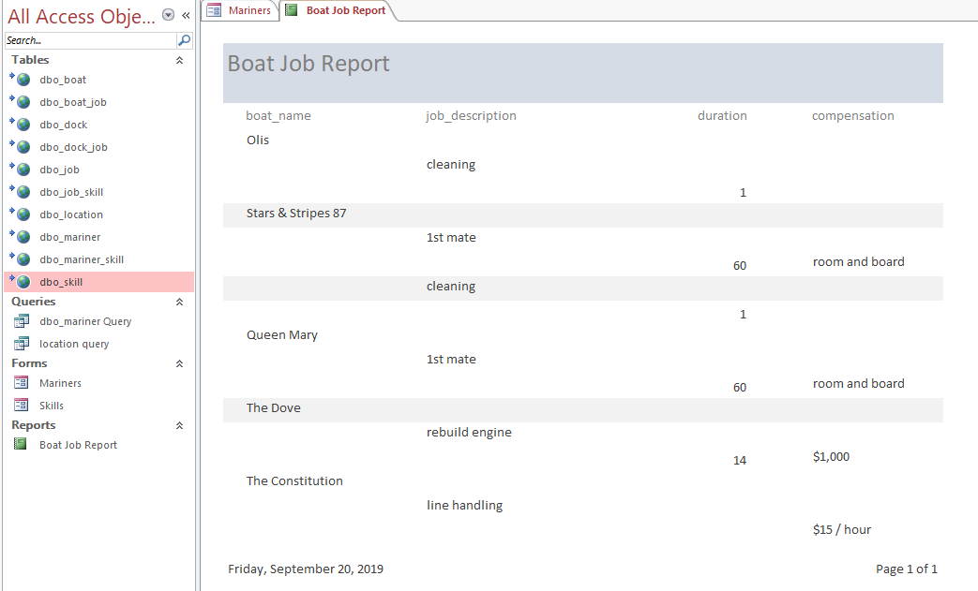
IST 659 Data Admin Concepts
Mariner Match
Business Objective – Match vendors and consumers in the maritime industry
SQL Back-end
MS Access Front-end
Required research on developing a business plan
Personal Hobby
Why – SQL and MS Access are common tools/Why – Mariner match satisfies an industry need

Slide 4
IST 659 Data Administration: Objectives/Lessons learned
Program Objectives
Develop a plan of action to implement the business decisions derived from the analysis
Demonstrate Communication Skills
Synthesize the ethical dimensions
Lessons Learned
Planning and Preparation prevents re-work
Business Thinking

Slide 5
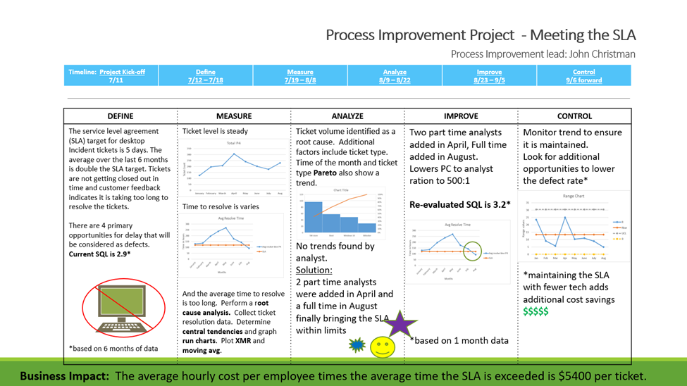
MBC 683 – Data Analysis &Decision Making
Helpdesk Process Improvement
Business Objective – Describe performance and Identify process improvements for Desktop Support
Real world data and problem
Data Driven solution
Graphics helped convey the problem and the solution
Leveraged Six Sigma certification
Why – Process analysis techniques define the problem/Why – Analysis proved the problem and the solution

Slide 6
MBC 683 – Data Analysis & Decision Making: Objectives/Lessons Learned
Program Objectives
Collect and Organize Data
Identify patterns in data via visualization, statistical analysis and data mining
Develop a plan of action to implement the business decisions
Demonstrate communication skills
Synthesize the ethical dimensions
Lesson’s learned
Range and Xbar charts highlighted the process to logically determine improvement targets and with data support
Understanding the proper way to identify the normal variance in a process supports the development of realistic improvement goals rather than setting random targets

Slide 7
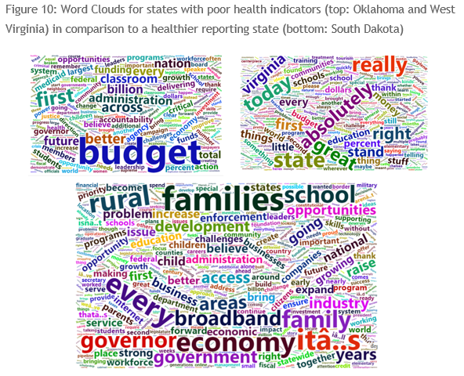
IST 707 Data Analytics
“How Your Health May Be Related to What Your Governor Says”
Business Objective – Identify relationships between the health of a state’s population and the tone of the Governor’s speeches
Group project
Coded in R
Start – finish data science problem
Multi-model/multi-data set
Why – Finding the best model, presenting the results/Why – Discovering what the data means

Slide 8
IST 707 Data Analytics: Objectives and Lessons Learned
Program Objectives
Collect and Organize data organization and reporting
Develop alternative strategies based on the data
Demonstrate communication skills
Synthesize the ethical dimensions
Lessons Learned
Effective team work on a data science project
Researching the meaning of the results
Effective report presentation

Slide 9
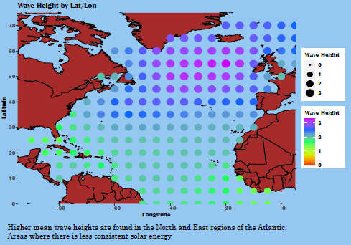
IST 719 Data Visualization/IST 689 Scripting
Catch a Wave/Waves of the Atlantic
Business Objective – Performance and Trends in Atlantic Ocean Wave height.
Produced a conference quality poster
Utilized R, Python and Adobe Illustrator
Ingested Twitter® data
Why – Visualizations are worth a 1000 words/Why – Green energy is a must for our future

Slide 10
IST 719 Data Visualization/IST 689 Scripting: Objectives and Lessons Learned
Program Objectives
Collect and Organize Data
Identify patterns in data via visualization, statistical analysis and data mining
Develop alternative strategies based on the data
Develop a plan of action to implement the business decisions
Demonstrate communication skills
Lessons Learned
Effective graphics
Working in multiple coding languages

Slide 11

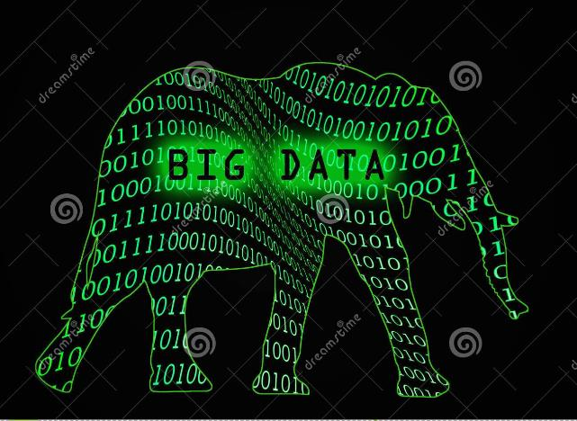


The End is just the Beginning
AI/ML challenges and opportunities in my current role
This Photo by Unknown Author is licensed under CC BY-SA-NC
Opportunities for a new career
The Reputation Of Syracuse
This Photo by Unknown Author is licensed under CC BY-SA

